Slide 1
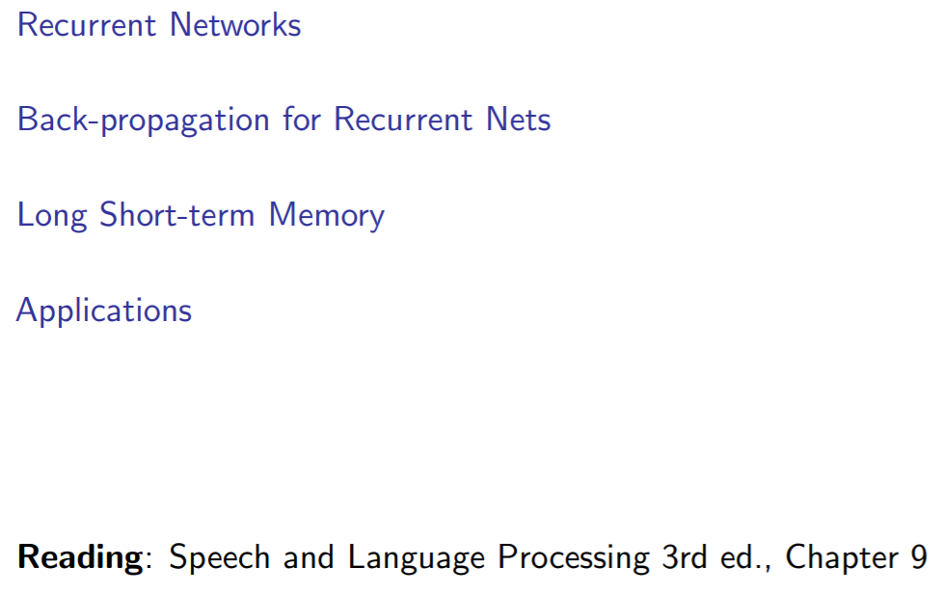
Contents

Slide 2
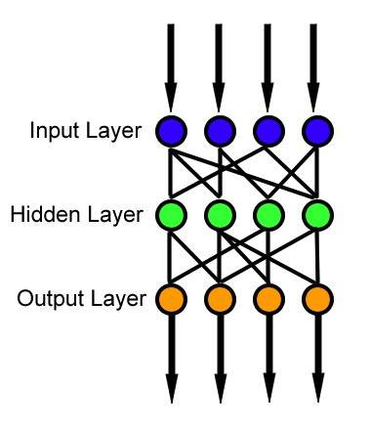
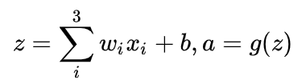
Review: Feedforward Neural Network

Slide 3
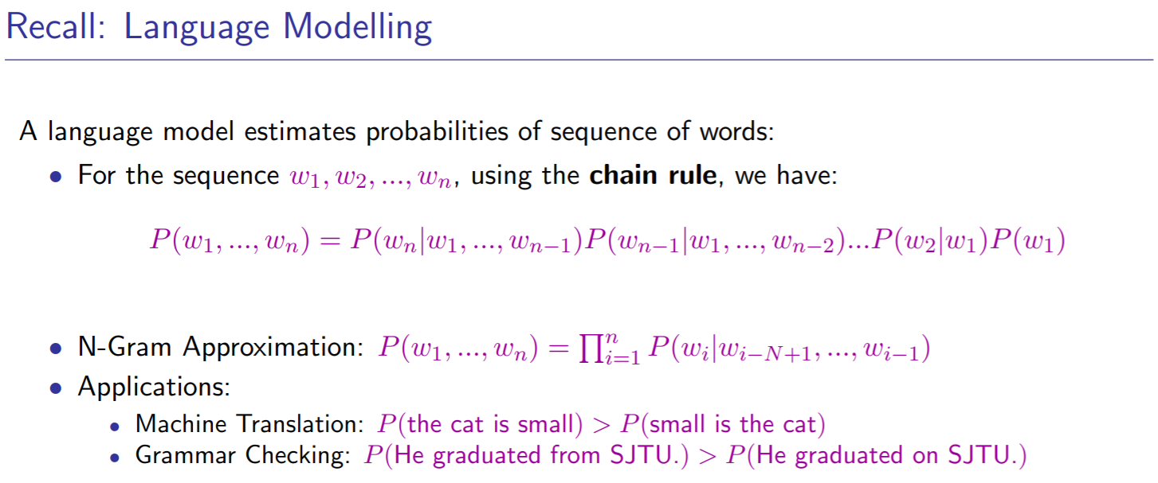

Slide 4
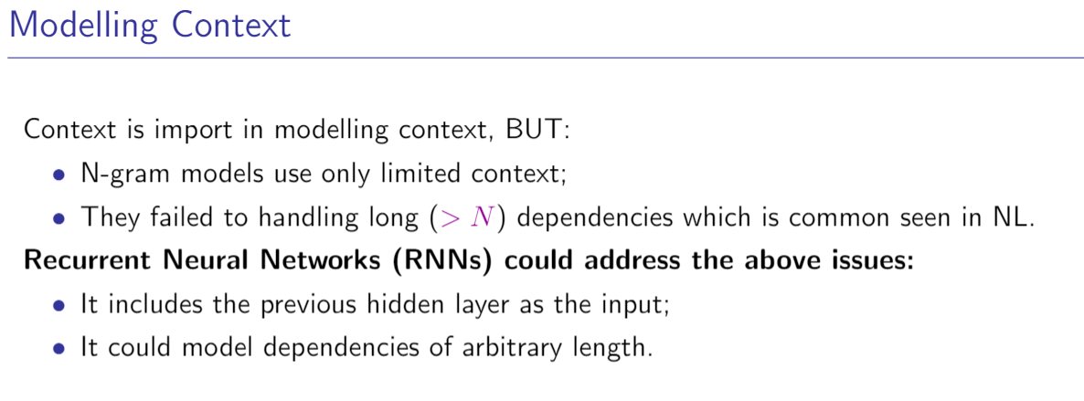

Slide 5
Why RNN?
通用近似定理 (Universal approximation theorem)
如果一个前馈神经网络具有线性输出层和至少一层隐藏层，只要给予网络足够数量的神经元，便可以实现以足够高精度来逼近任意一个在 ℝn 的紧子集 (Compact subset) 上的连续函数
Why don’t use FNN directly?

Slide 6
Why RNN?
我
爱
北京
nn
v
nn

Slide 7
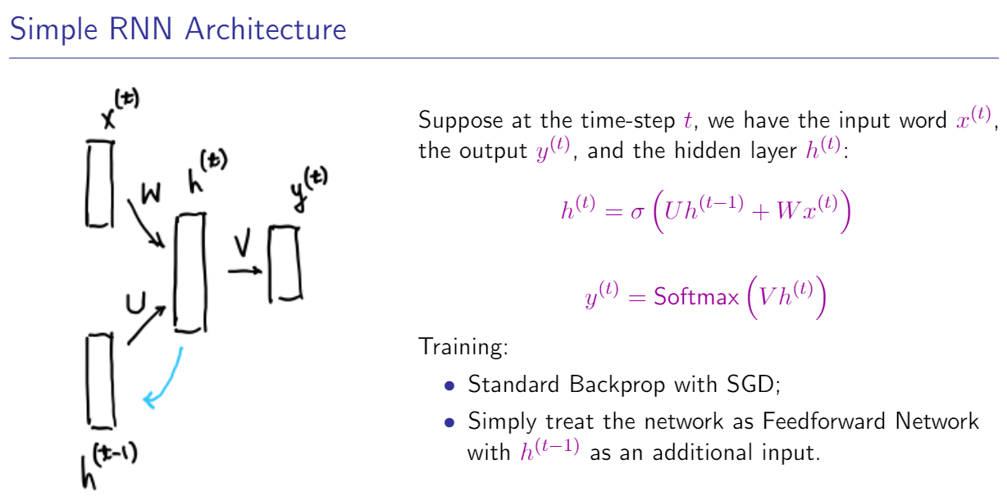

Slide 8


Slide 9
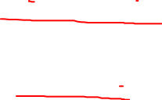

Slide 10
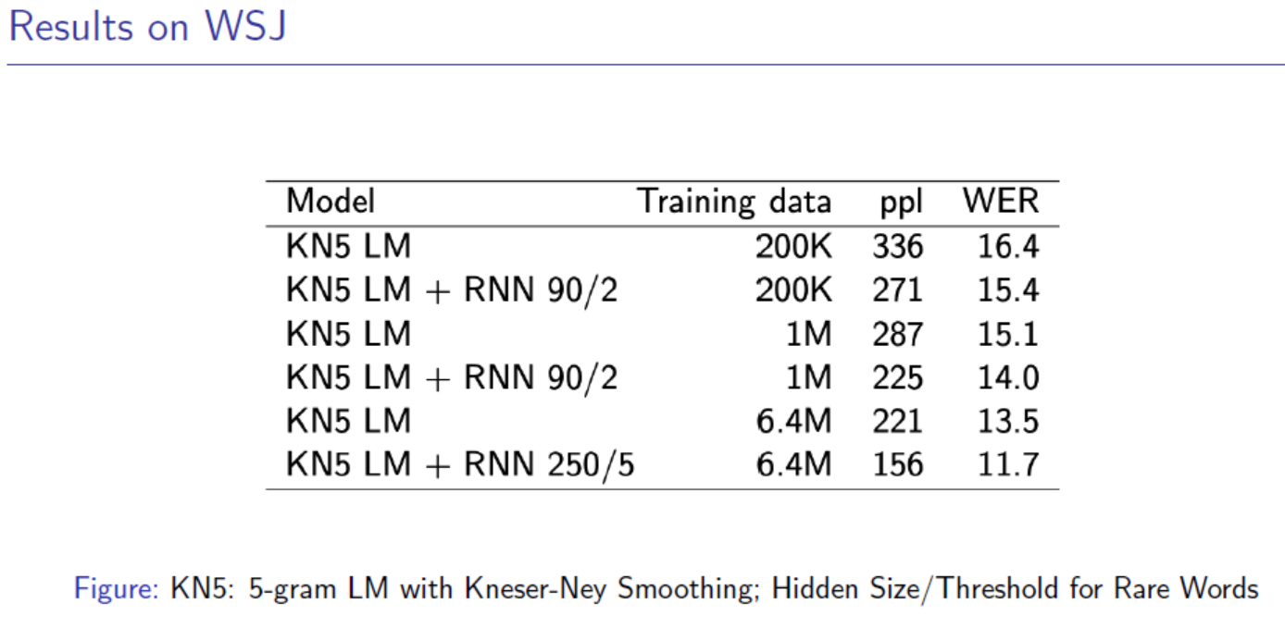
ppl：困惑度，也就是得在多少个词中进行选择
Details about ppl and WER: https://www.cs.cmu.edu/~roni/papers/eval-metrics-bntuw-9802.pdf

Slide 11
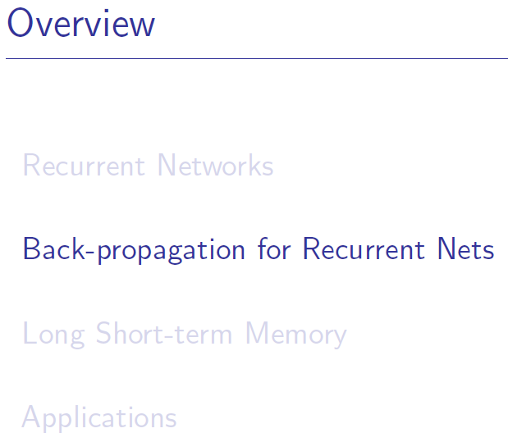

Slide 12
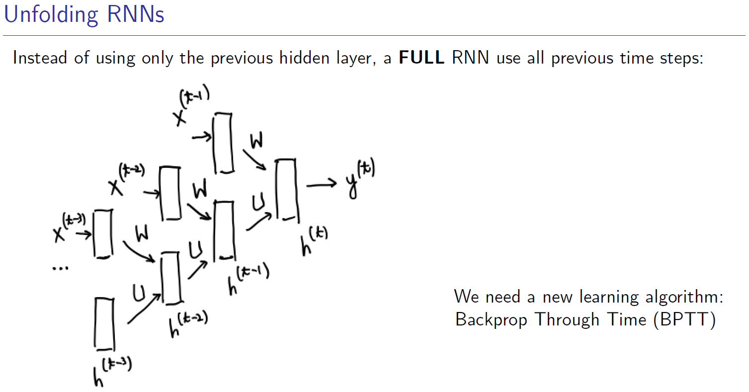

Slide 13
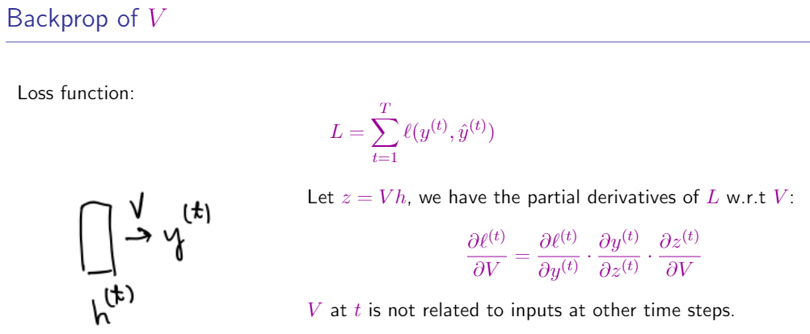

Slide 14
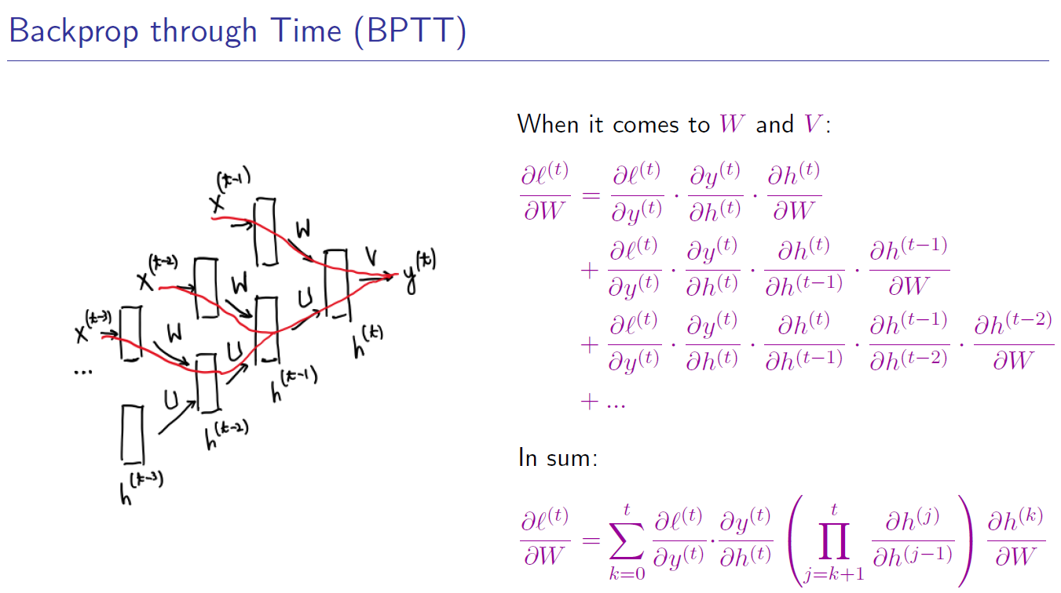

Slide 15
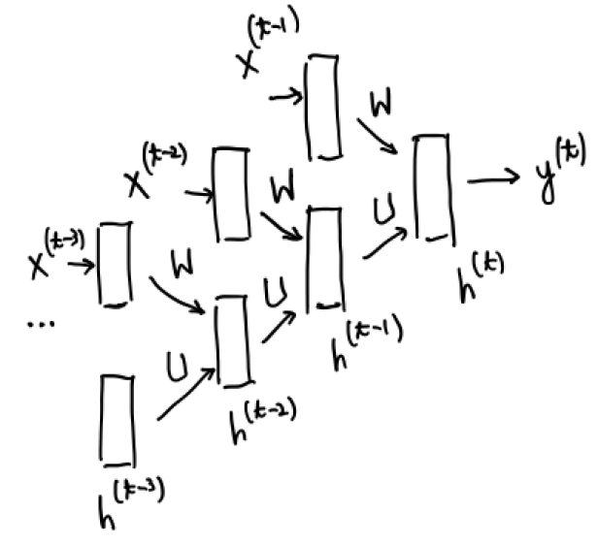
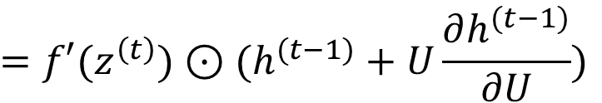
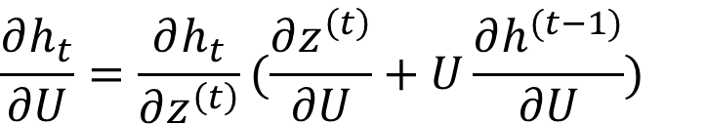
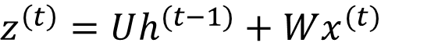
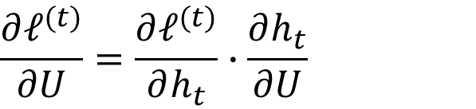
Real-Time Recurrent Learning (RTRL)
$$\frac{∂ℓ^{(t)}}{∂U}=\frac{∂ℓ^{(t)}}{∂h_{t}}∙\frac{∂h_{t}}{∂U}$$
$$h^{(t)}=f\left(z^{\left(t\right)}\right)=f\left(Uh^{(t−1)}+Wx^{(t)}\right),$$
$$z^{\left(t\right)}=Uh^{(t−1)}+Wx^{(t)}$$
$$\frac{∂h_{t}}{∂U}=\frac{∂h_{t}}{∂z^{\left(t\right)}}(\frac{∂z^{\left(t\right)}}{∂U}+U\frac{∂h^{(t−1)}}{∂U})$$
$$=f′(z^{\left(t\right)})⊙(h^{(t−1)}+U\frac{∂h^{(t−1)}}{∂U})$$

Slide 16
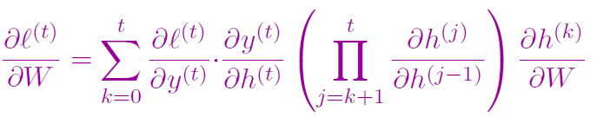
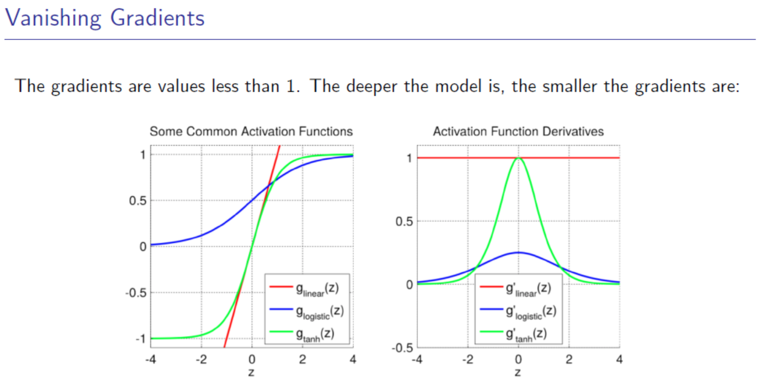

Slide 17
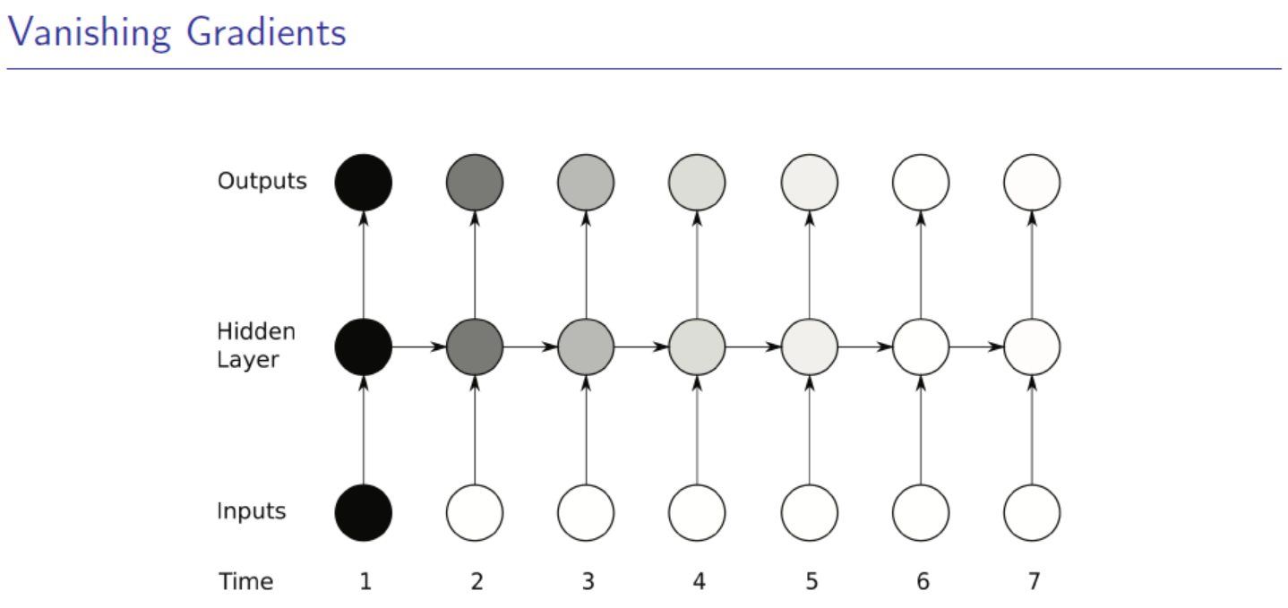

Slide 18
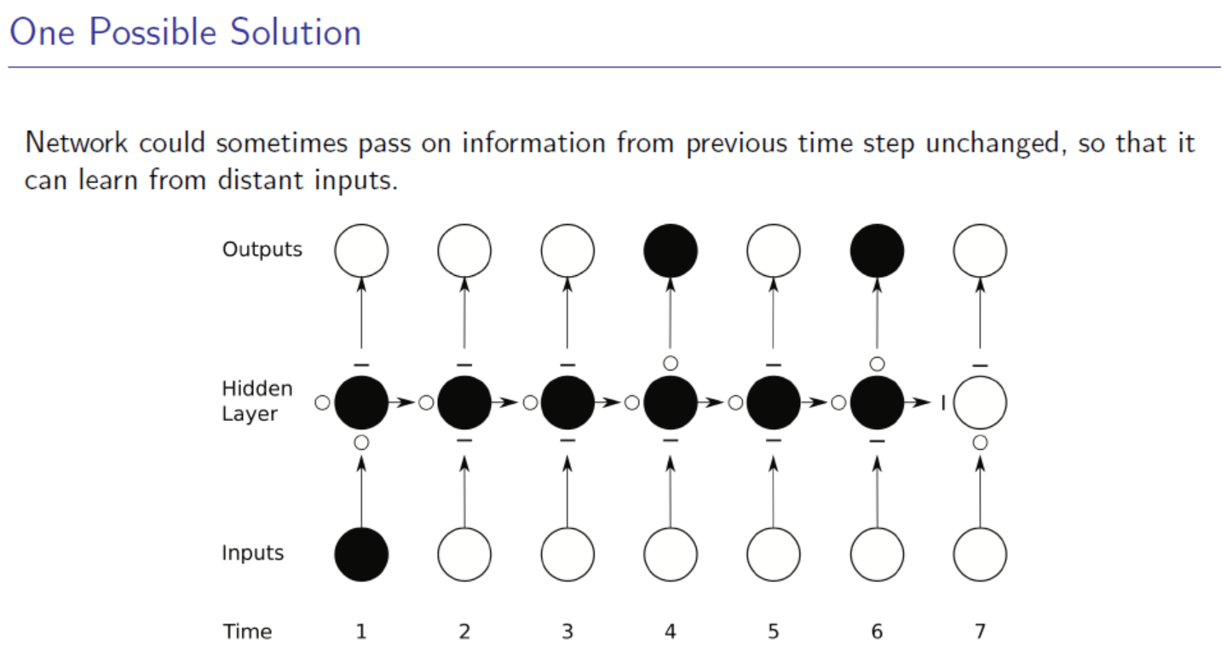

Slide 19
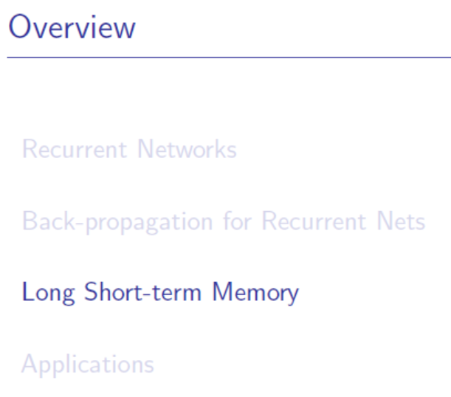

Slide 20
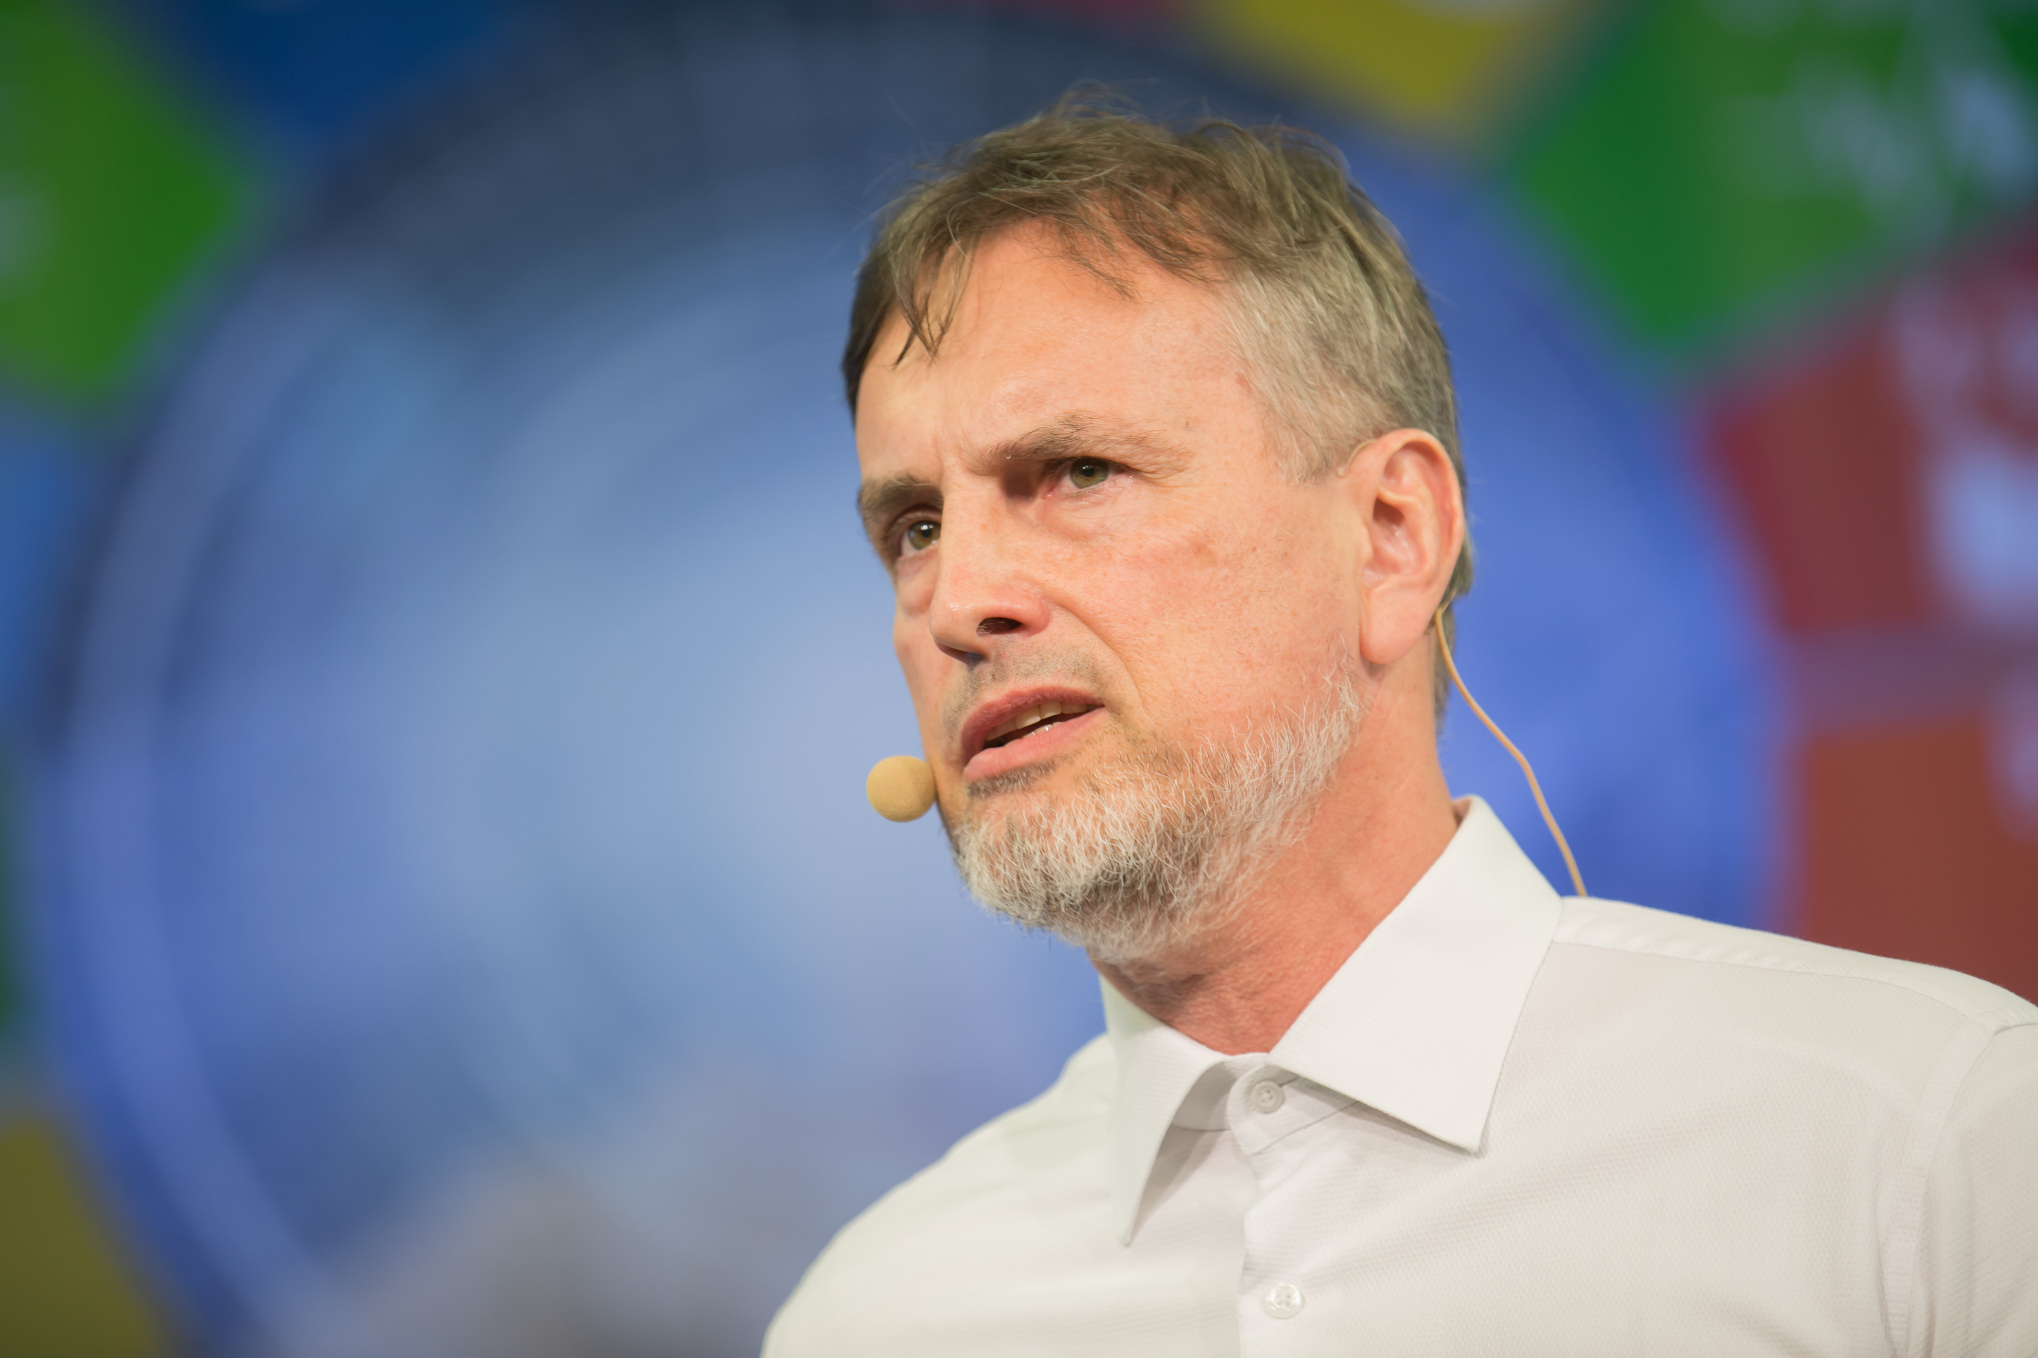
Jürgen Schmidhuber

Slide 21

Naïve RNN

Slide 22

LSTM (Long Short-Term Memory)

Slide 23

Core Idea of the LSTM: Gate

Slide 24

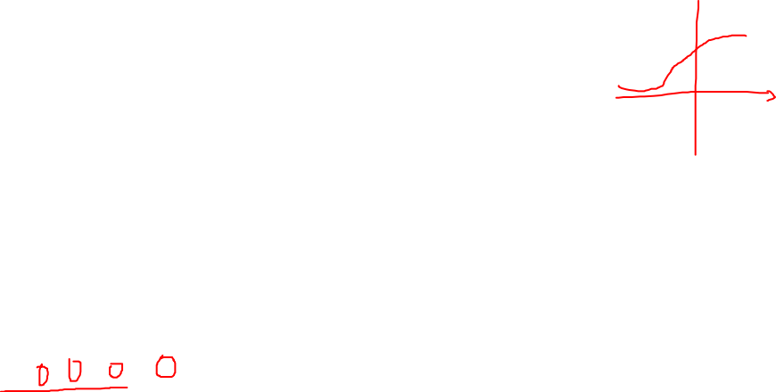
Core Idea of the LSTM: Detail
“Forget Gate”

Slide 25

Core Idea of the LSTM: Detail
“Input Gate”

Slide 26

Core Idea of the LSTM: Detail

Slide 27

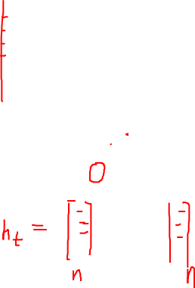
Core Idea of the LSTM: Detail
“Output Gate”

Slide 28
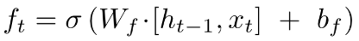
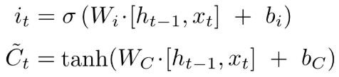
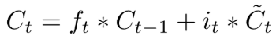
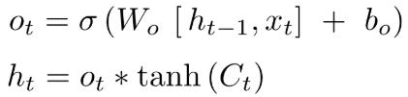
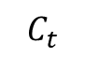
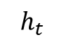
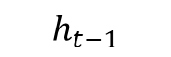
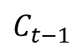
Core Idea of the LSTM: Detail
$$C_{t−1}$$
$$C_{t}$$
$$h_{t−1}$$
$$h_{t}$$
More info: https://colah.github.io/posts/2015-08-Understanding-LSTMs/

Slide 29
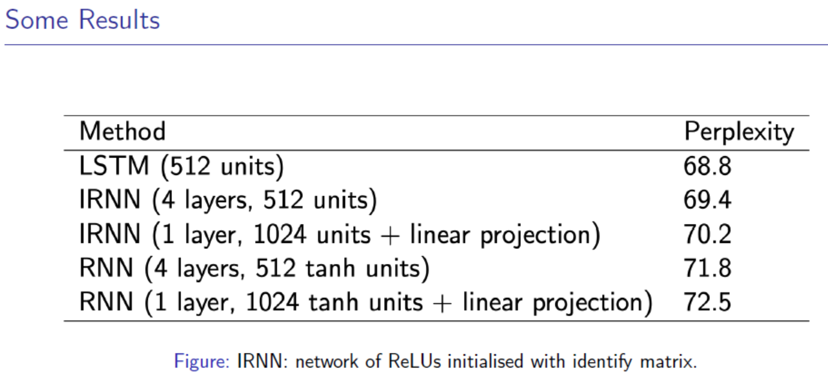

Slide 30
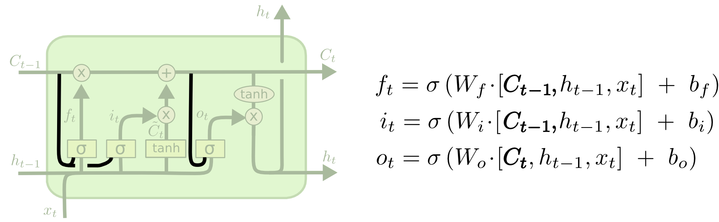
Variants on LSTM: adding peephole

Slide 31
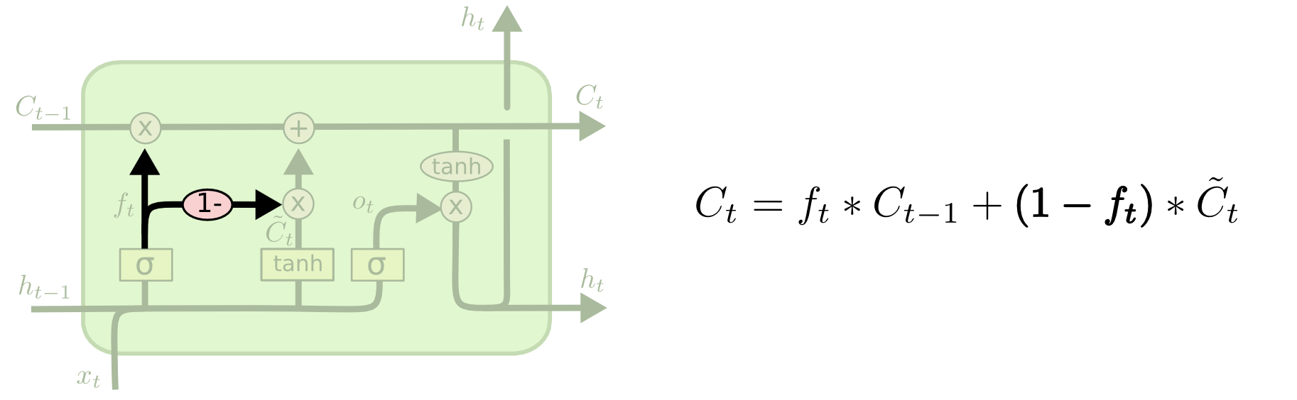
Variants on LSTM: forget while input

Slide 32

Variants on LSTM: GRU
Ref: Learning Phrase Representations using RNN Encoder–Decoder for Statistical Machine Translation

Slide 33
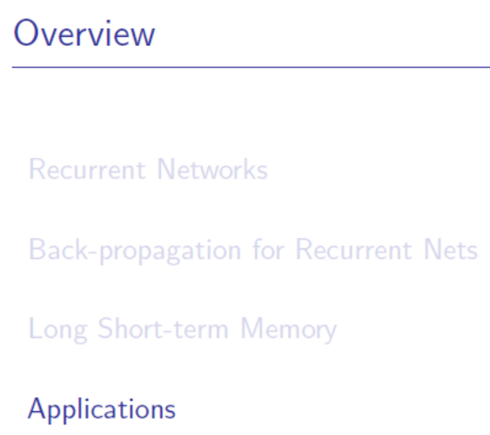

Slide 34
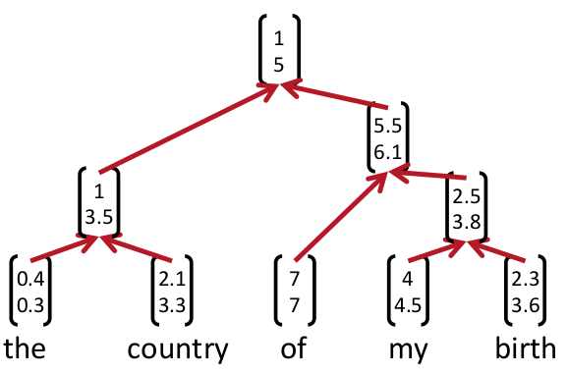
递归神经网络（recursive neural networks）

Slide 35
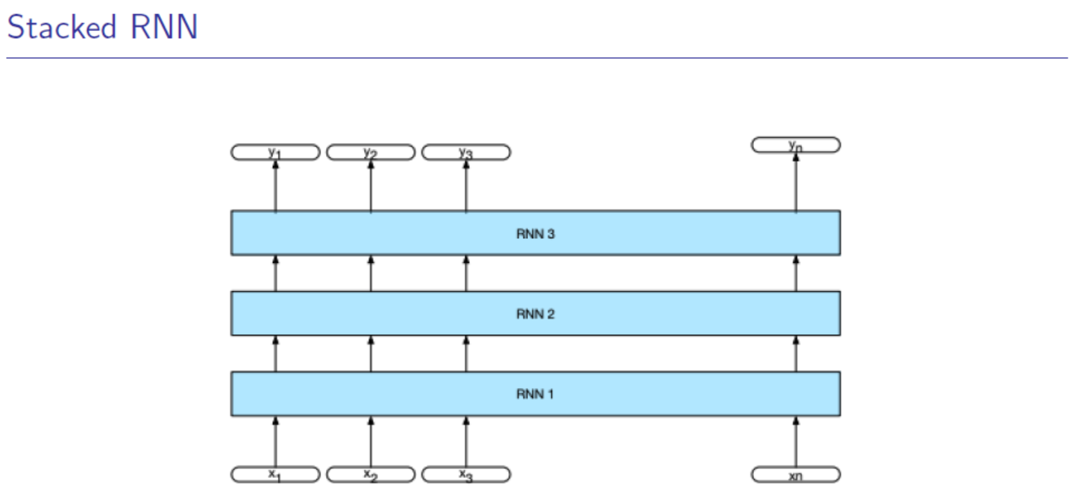
Notes:
然后还有堆叠RNN。
就是在一层RNN上再叠一层。

Slide 36
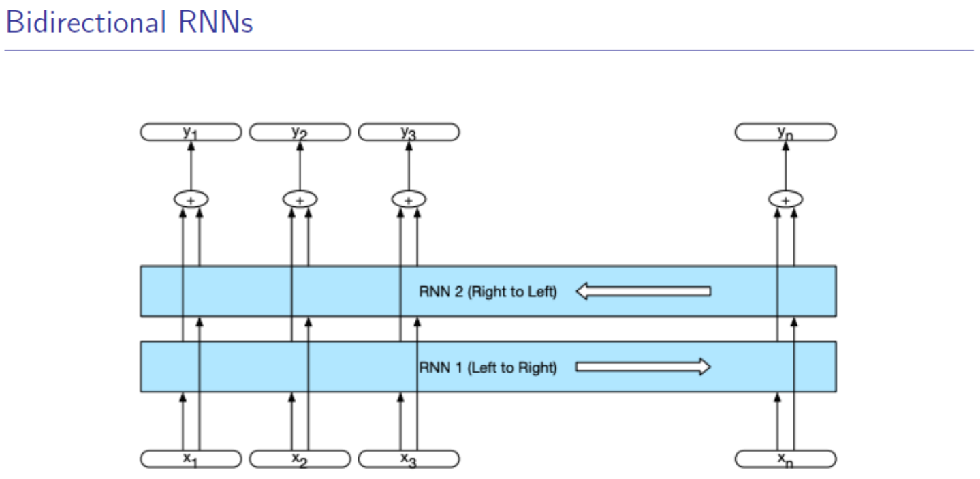
Notes:
还有双向的rnn

Slide 37
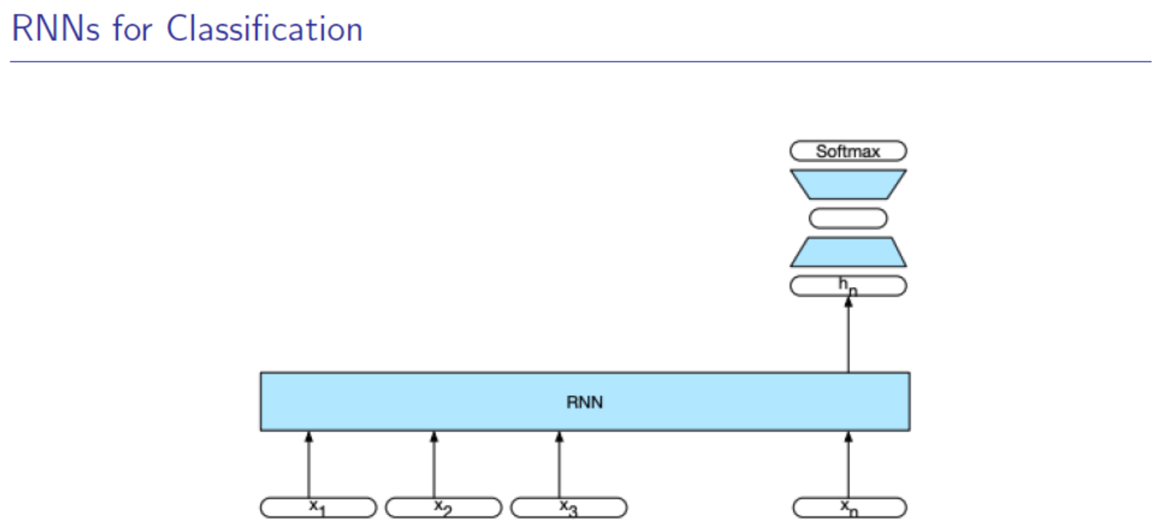
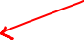
Notes:
还有分类器

Slide 38
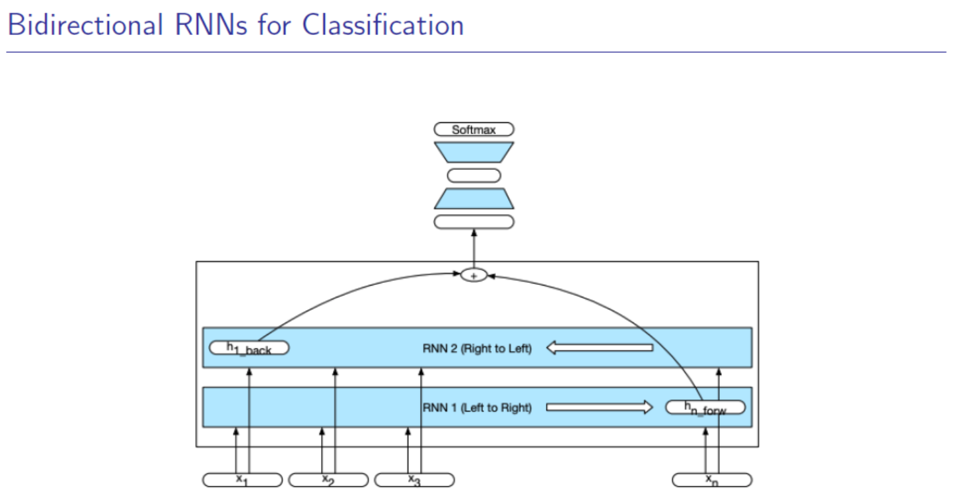
Notes:
当然还有一个双向分类器

Slide 39
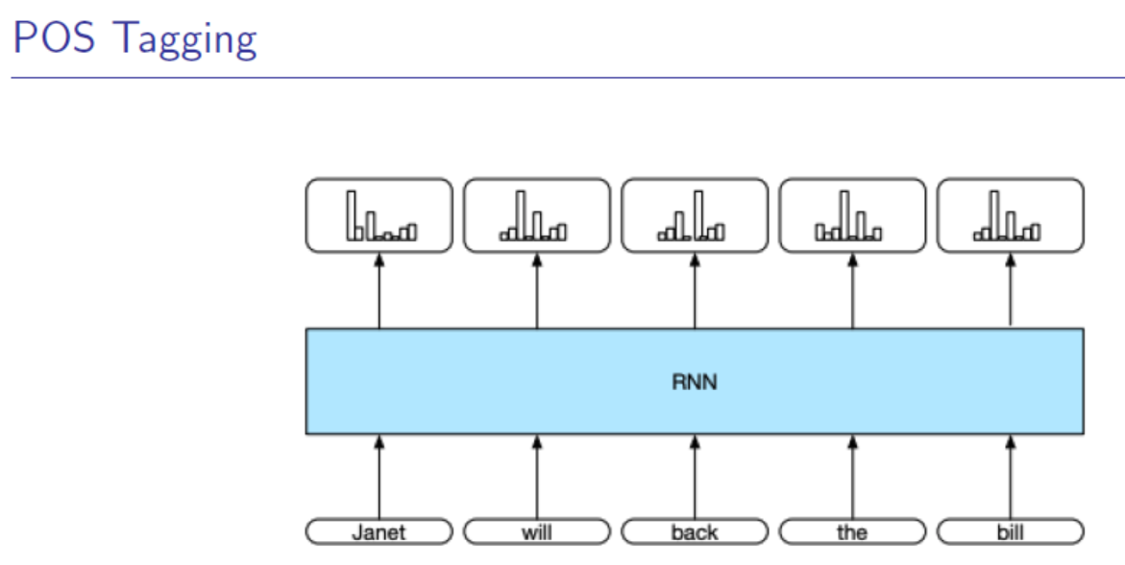

Slide 40


Slide 41
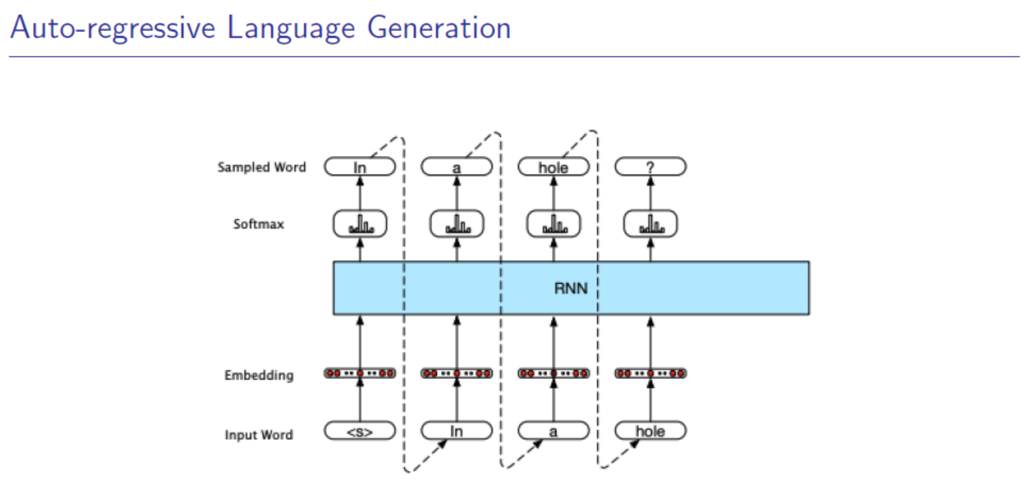
Notes:
自回归的语言生成任务

Slide 42
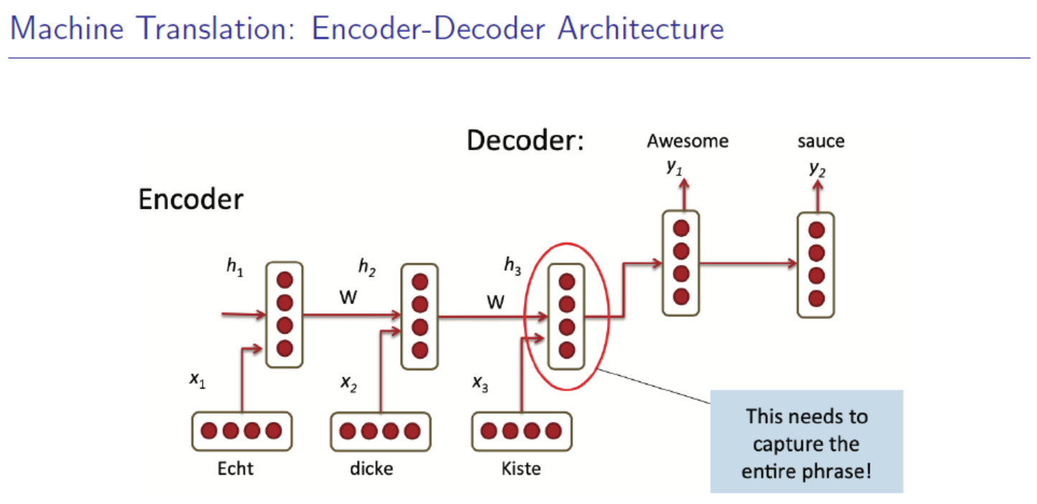
Notes:
当然还有机器翻译里面
在机器翻译里面我们会用一个叫sequence to sequence 的模型。

Slide 43
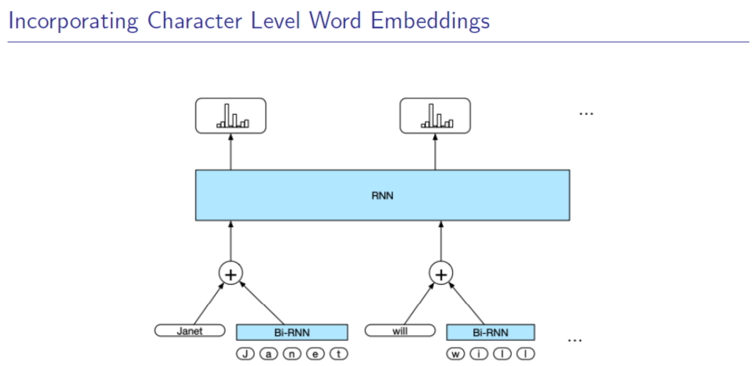
Notes:
然后rnn还可以用来编码字符级别的内容

Slide 44
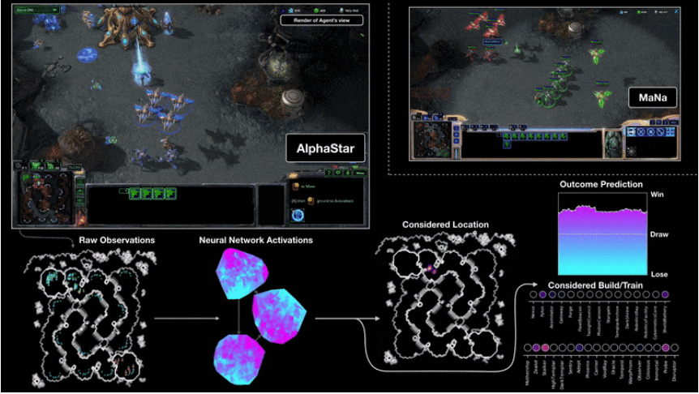
Notes:
当然还有alpha star

Slide 45
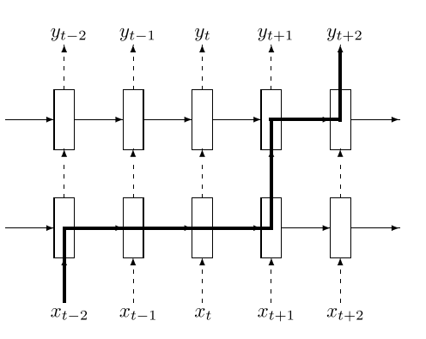
Dropout
Zaremba et al. (2014) Regularized multilayer RNN. Dropout is only applied to the non-recurrent connections (ie only applied to the feedforward dashed lines). The thick line shows a typical path of information flow in the LSTM. The information is affected by dropout L + 1 times, where L is depth of network.

Slide 46
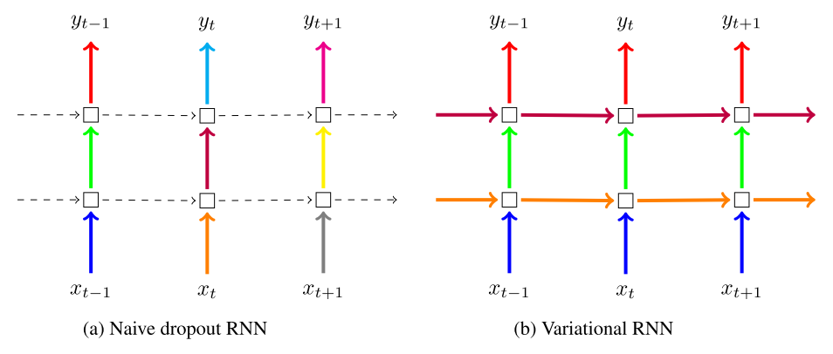
Dropout
after Gal and Ghahramani (2015). Naive dropout (a) (eg Zaremba et al., 2014) uses different masks at different time steps, with no dropout on the recurrent layers. Variational Dropout (b) uses the same dropout mask at each time step, including the recurrent layers (colours representing dropout masks, solid lines representing dropout, dashed lines representing standard connections with no dropout).
Further Reading: https://medium.com/@bingobee01/a-review-of-dropout-as-applied-to-rnns-72e79ecd5b7b

